Slide 1
Creating REST and GraphQL Database Endpoints with Data API Builder
Leonard Lobel
Bay Area Azure and AI
July 12, 2023

Slide 2




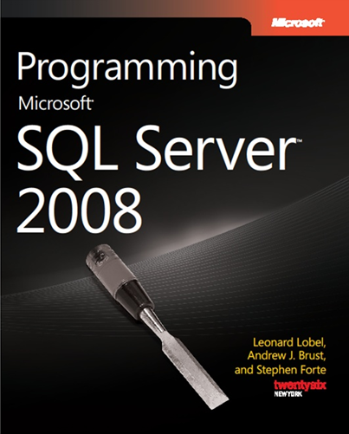
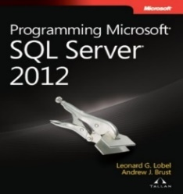
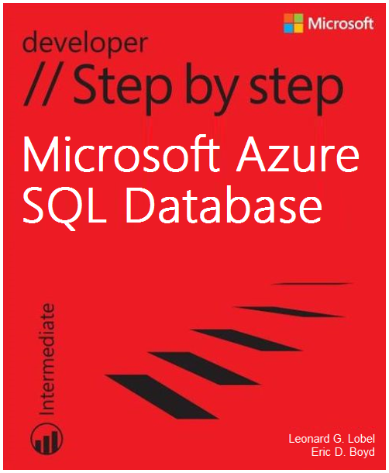
About Me
sleek technologies
Leonard Lobel
CTO & Co-Founder
Sleek Technologies, Inc.
Microsoft Consultant
Ernst & Young
Microsoft MVP
Data Platform
Trainer/Speaker/Author
Programming since 1979
Contact
Email
lenni.lobel@sleektech.com
Blog
lennilobel.wordpress.com
Twitter
@lennilobel

Slide 3
Download Slides and Code
http://bit.ly/ bayarea2023_dab
(all lower case!)

Slide 4




What is Data API Builder?
Just what it sounds like!
Build an API over your database(s)
Expose database operations
Create API endpoints REST and/or GraphQL
Cross platform and open source
Windows, Linux, MacOS https://github.com/Azure/data-api-builder
SQL (relational) databases (on-prem, or Azure)
Tables, views, stored procedures Azure SQL, SQL Server, PostgreSQL, MySQL
NoSQL (non-relational) databases
JSON documents in Azure Cosmos DB
Security
Authentication (OAuth2/JWT, EasyAuth) Authorization (role-based using claims) Item-level security (policy expressions)
Notes:
https://learn.microsoft.com/en-us/azure/data-api-builder/overview-to-data-api-builder

Slide 5
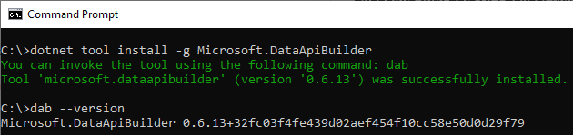
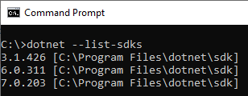
Getting Started with DAB
Install .NET 6
Check installed SDKs dotnet --list-sdks
If .NET 6 SDK isn’t installed https://learn.microsoft.com/en-us/dotnet/core/install/
Install the DAB CLI
dotnet tool install –g Microsoft.DataApiBuilder
dab --version
Notes:
https://learn.microsoft.com/en-us/azure/data-api-builder/overview-to-data-api-builder

Slide 6
Using the DAB CLI
Initialize the configuration file
dab init [options]
Add database entities
dab add [entity-name] [options]
Update entity properties
dab update [entity-name] [options]
Start the runtime engine
dab start
Notes:
https://learn.microsoft.com/en-us/azure/data-api-builder/overview-to-data-api-builder

Slide 7
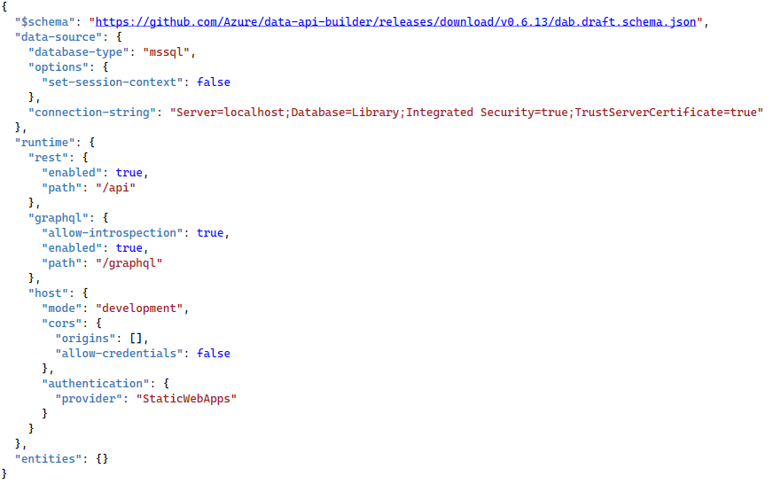
DAB Configuration File
Data source
Database type and connection string
Runtime settings
Runtime behavior (REST/GraphQL configuration)
Entity definitions
Database object mappings
Notes:
https://learn.microsoft.com/en-us/azure/data-api-builder/configuration-file

Slide 8
DAB Configuration File
Data source
database-type | For…
mssql | Azure SQL DB, Azure SQL MI, SQL Server
postgresql | PostgreSQL
mysql | MySQL
cosmosdb_nosql | Cosmos DB NoSQL API (JSON documents)
cosmosdb_postgresql | Cosmos DB PostgreSQL API
Notes:
https://learn.microsoft.com/en-us/azure/data-api-builder/configuration-file

Slide 9
DAB Configuration File
Runtime global settings
Property | Description
rest | Path for REST endpoints
graphql | Path for GraphQL endpoints
host | Mode (prod/dev), CORS, authentication
Notes:
https://learn.microsoft.com/en-us/azure/data-api-builder/configuration-file

Slide 10
DAB Configuration File
Entities
Property | Description
<entity-name> | Entity name exposed by the data API
source | Physical database object name (table, view, stored procedure)
rest | Expose entity via REST (true/false)
graphql | Expose entity via GraphQL (true/false)
permissions | Array of allowed role/actions for the entity
Notes:
https://learn.microsoft.com/en-us/azure/data-api-builder/configuration-file

Slide 11
Data API Builder

Slide 12
Thank You!
Contact Me
lenni.lobel@sleektech.com
Visit my blog
lennilobel.wordpress.com
Follow me on Twitter
@lennilobel
Thanks for coming!
☺
Notes:
Fluent-API-style programming language
Chain multiple steps together
Define vertices and edges with properties
.addV(‘label’)
.addE(‘label’).to(vertex)
.property(‘key’, ‘value’)
Query on filters and relationships
.V(‘label’)
.out(‘label’)
.has(‘property’, condition)

